Slide 1
INTRODUCTION TO HUMAN COMPUTER INTERACTION
Nguyen Nhu Y_4251050188
time：9/2022
teacher ：Le Quang Hung

Slide 2
Introduction
Definition of the problem addressed
Review of related word
Analysis of User Requirements
First Generation Prototypes
CONTENTS
Second Generation Prototype
Conclusion

Slide 3
Introduction

Slide 4
Definition of the problem addressed

Slide 5
Review of related word

Slide 6
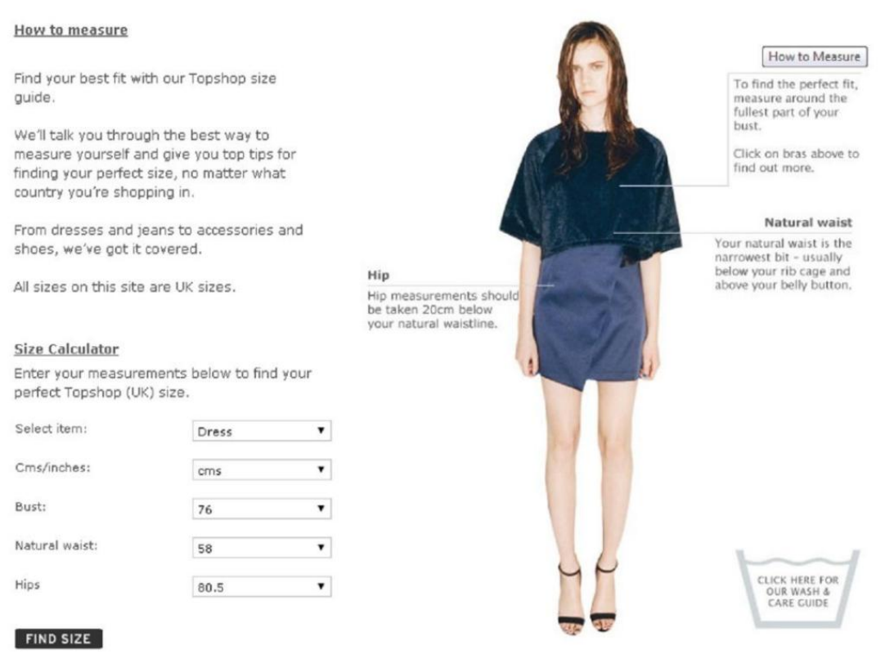
Review of related work
TOPSHOP
Sizing charts and available help when choosing size
Model Sizes
Suggestions of similar products; complementary item details
Interface

Slide 7
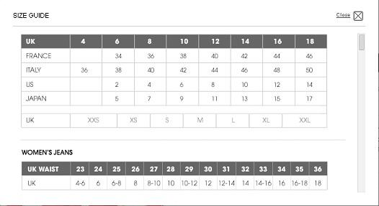
Review of related work
SELFRIDGES
Sizing charts and available help when choosing size
Model Sizes
Suggestions of similar products; complementary item details
Interface

Slide 8
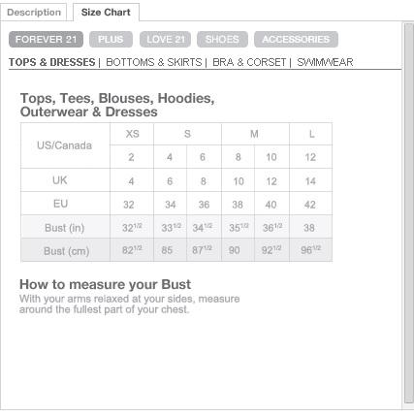
Review of related work
FOREVER 21
Sizing charts and available help when choosing size
Model Sizes
Suggestions of similar products; complementary item details
Interface

Slide 9
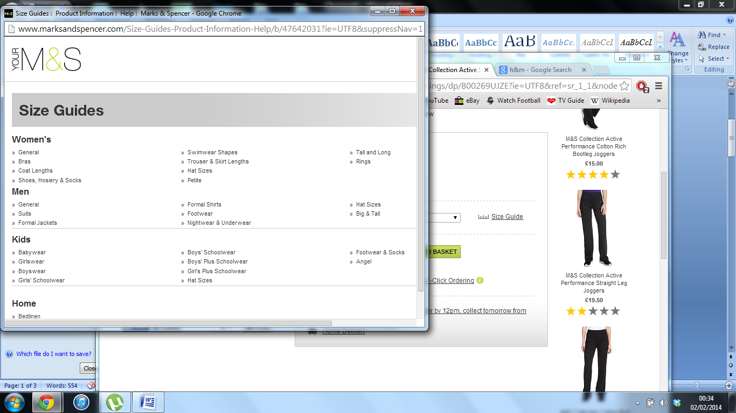
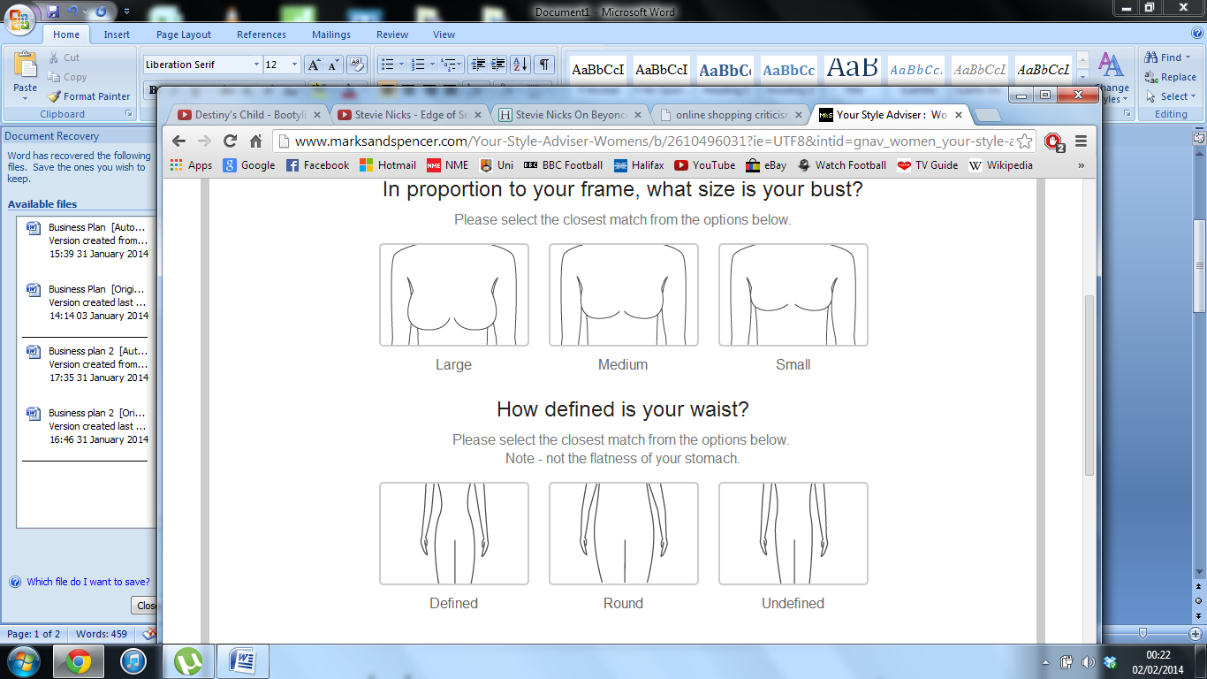
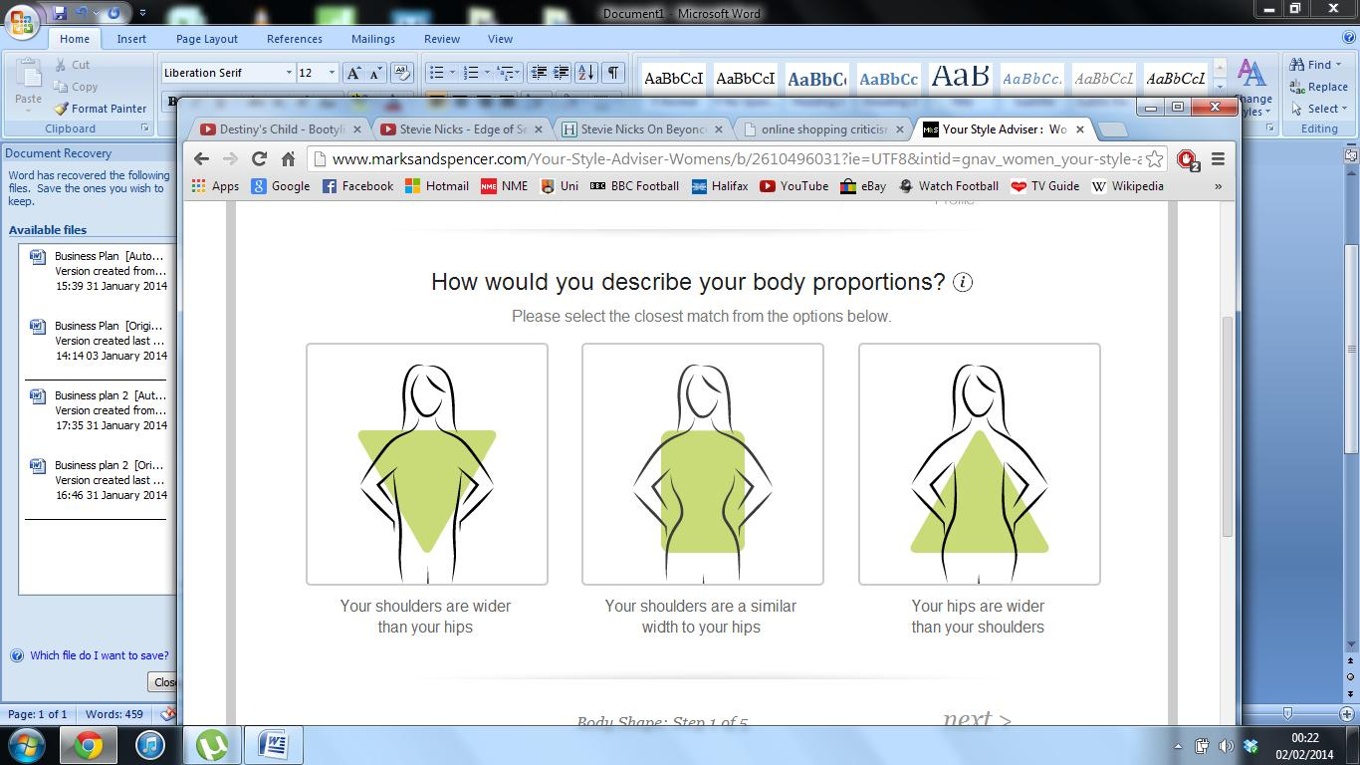
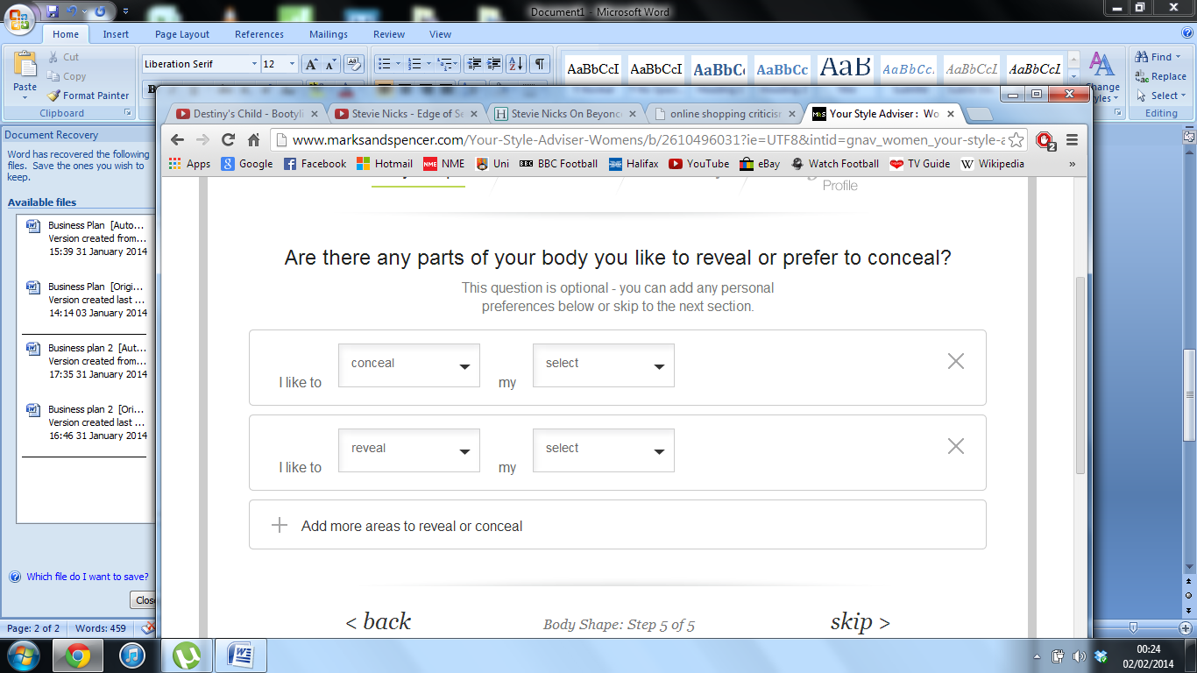
Review of related work
MARKS AND SPENCER
Sizing charts and available help when choosing size
Model Sizes
Suggestions of similar products; complementary item details
Interface

Slide 10
Review of related work
ZARA
ASOS
H&M
RIVER ISLAND
MANGO

Slide 11
Review of related work
URBAN OUTFITTERS
NEXT
JOHN LEWIS
VERY
NEW LOOK
DEBENHAMS

Slide 12
Analysis of User Requirements

Slide 13



Analysis of User Requirements
Sophie(20)
Studies International Relations and Politics
Anne(60)
Housewife, mother of three children
Belinda(29)
Lawyer at a top Law firm in the country

Slide 14
First Generation Prototypes

Slide 15
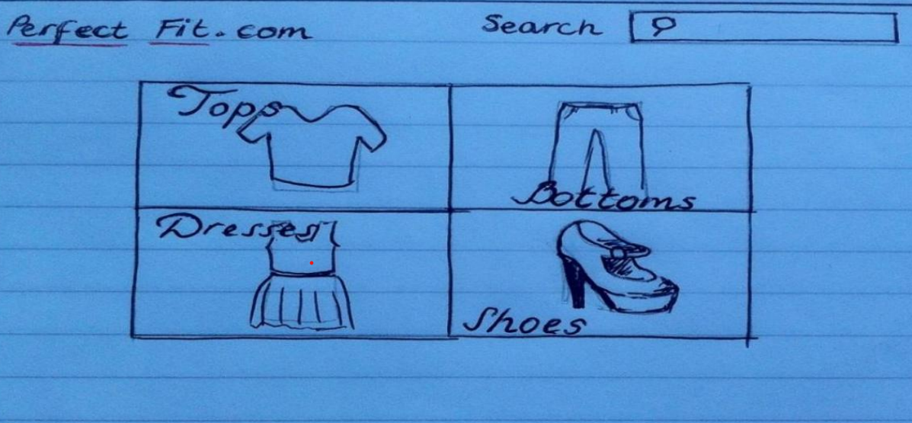
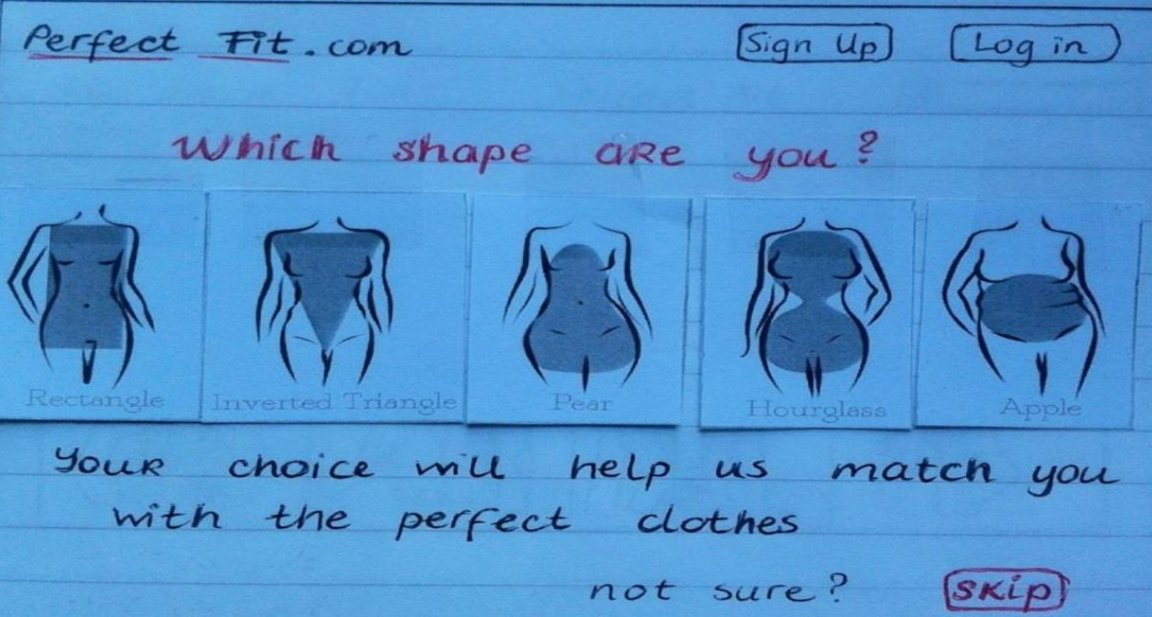
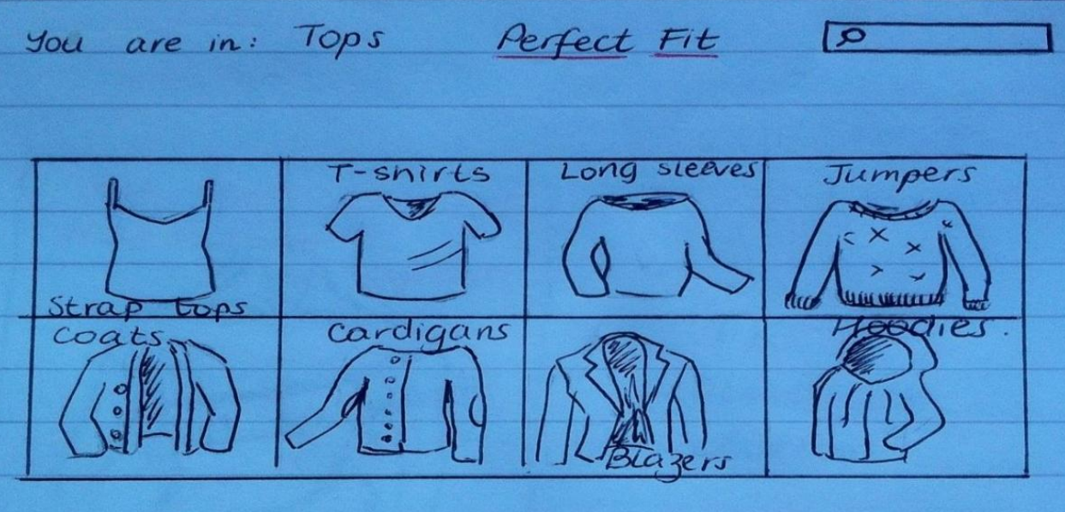
First Generation Prototypes

Slide 16
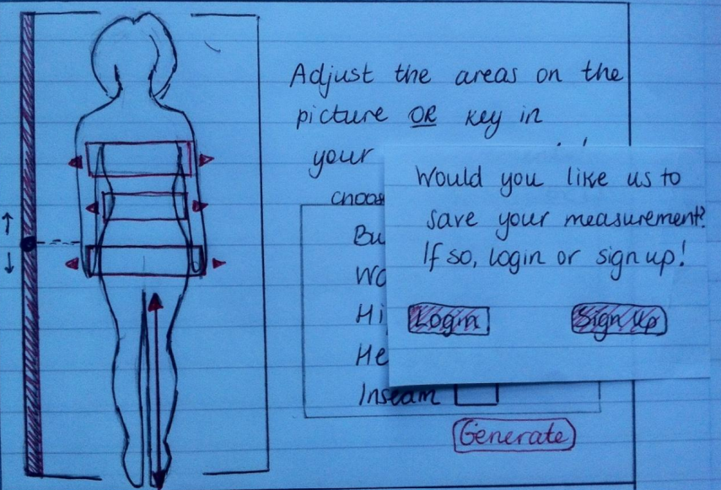
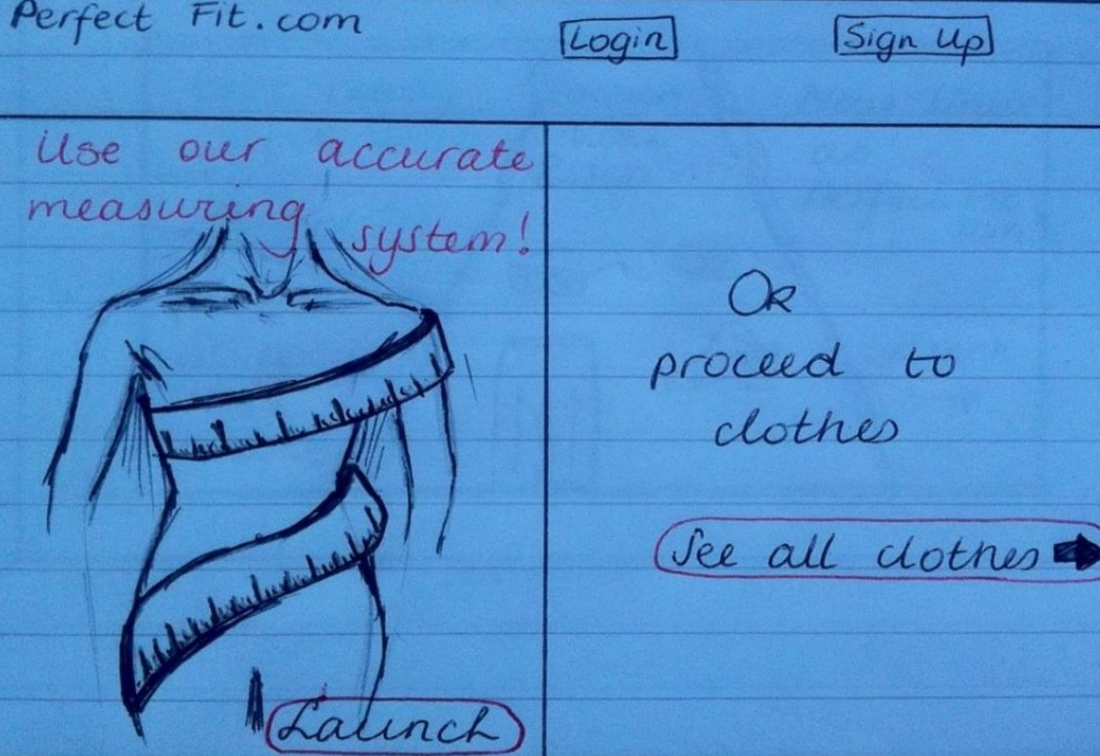
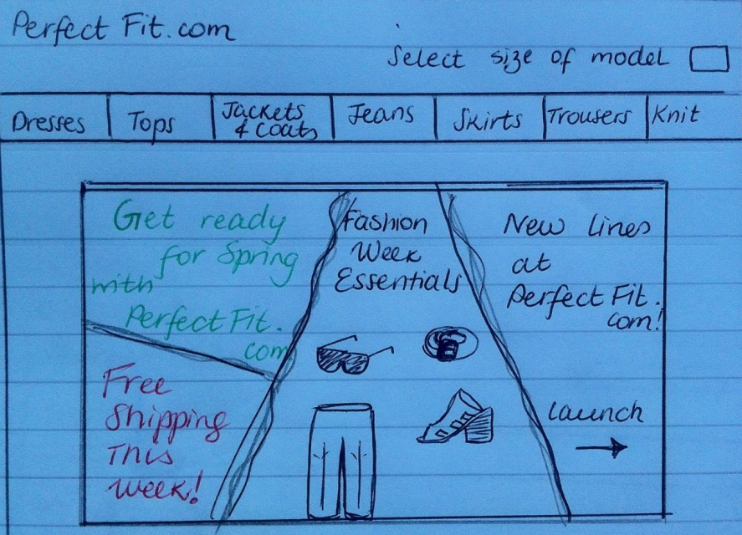
First Generation Prototypes

Slide 17
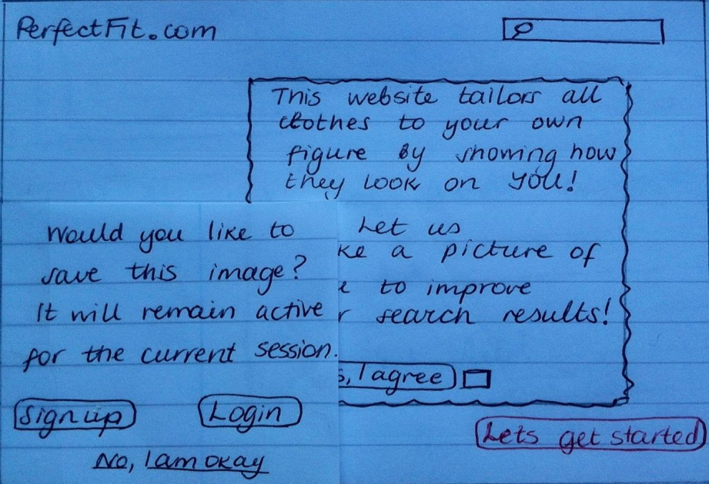
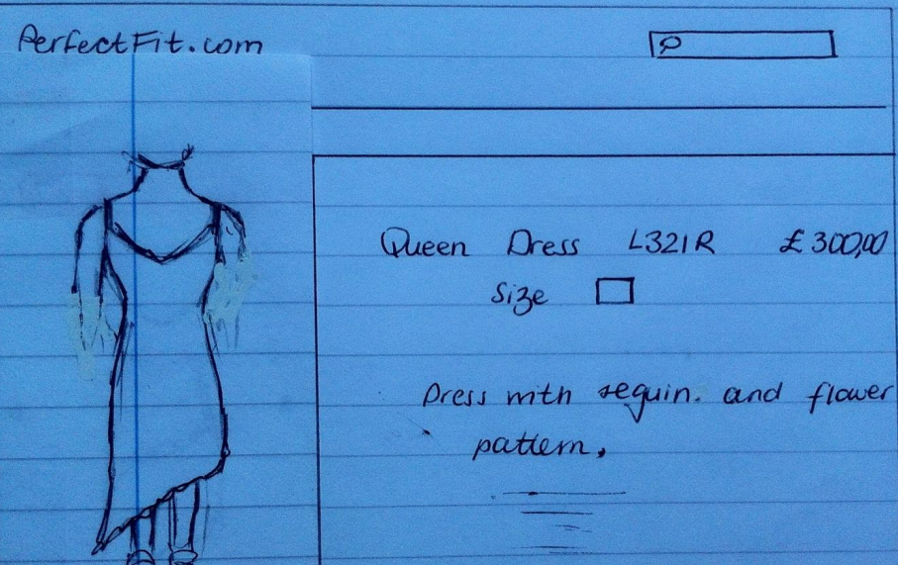
First Generation Prototypes

Slide 18
Second Generation Prototype

Slide 19
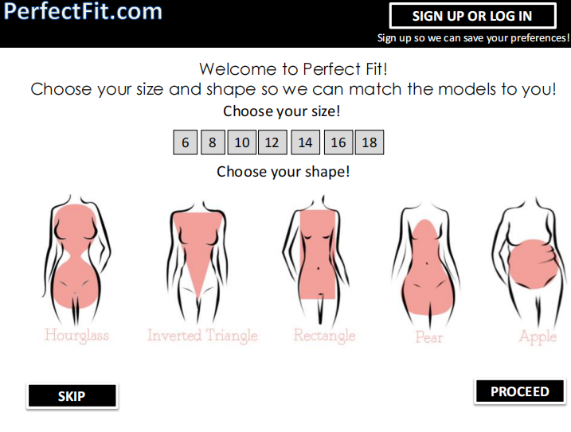
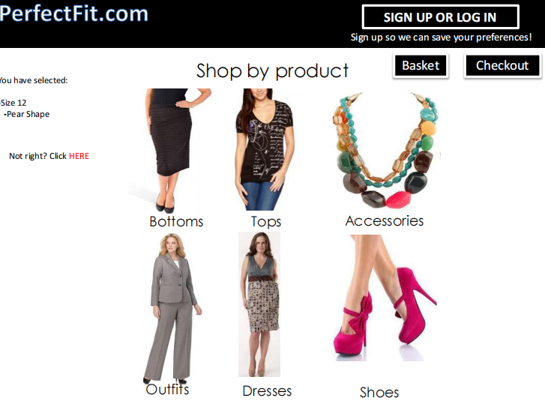
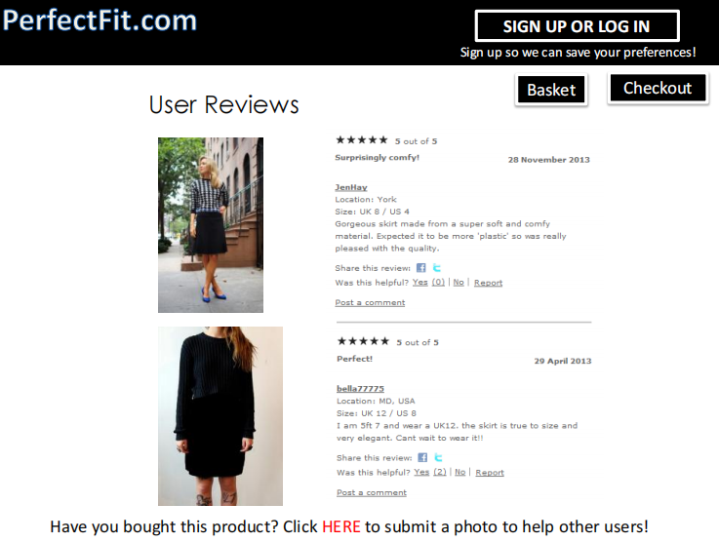
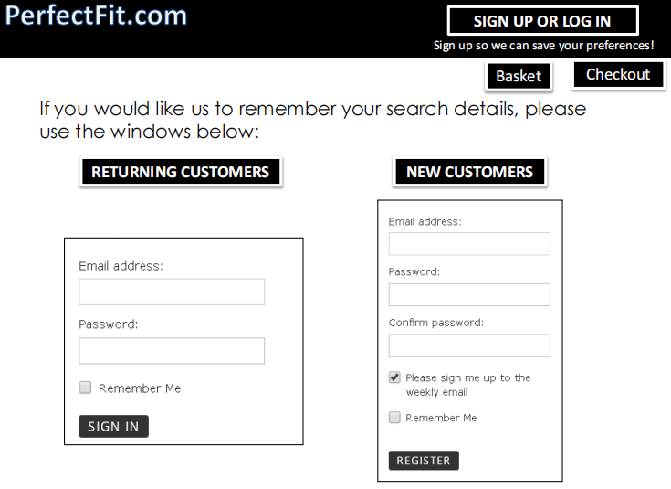
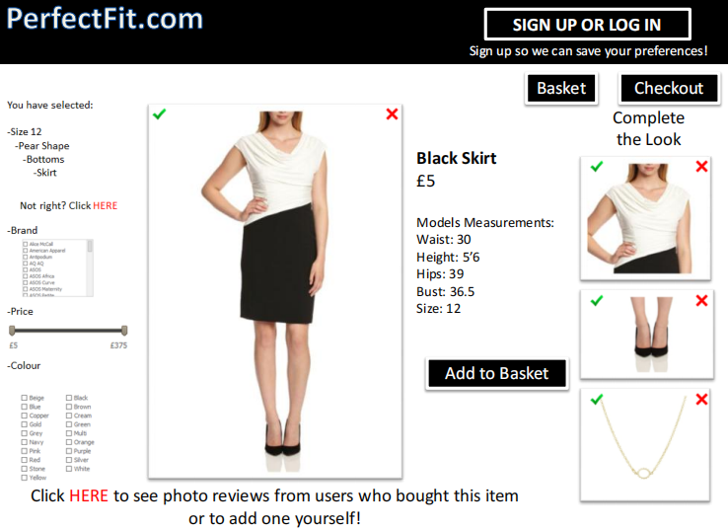
Second Generation Prototype

Slide 20
Conclusion

Slide 21
Thank you for listening
time: 9/2022
teacher ：Le Quang Hung

